Slide 1
Shoulder Evaluation
Unit One – Shoulder Injuries
Lesson Five

Slide 2
BELLWORK!
Think back to our SOAP Note practice from the first week of school:
  What does each letter of SOAP stand for?
  What type of information goes into each section of a SOAP note?

Slide 3
OBJECTIVES:
1. Define and recall key evaluation terminology.
2. Use effective questioning techniques to gather pertinent information.
3. Justify appropriate evaluation techniques using organizational tools.
4. Accurately record data to evaluate injury.

Slide 4
HOPS/SOAP REVIEW
Subjective - Detailed information about patient history, complaints
Objective - Information that is record of test measurements; data gained from inspection
Assessment - Identification of problem; diagnosis & differential
Plan - Plan of action; Treatment
History - questions to determine nature location of injury
Observation - Visual examination of injury
Palpation - A hands-on exam
Stress tests - Tests to check range of motion and degree or injury

Slide 5
Subjective vs. Objective
Football player comes off field holding his arm and said he just fall on the point of his shoulder. You can see the lump on his shoulder and he is unable to reach over to his other shoulder. The pain is a 6/10.

Slide 6
History
Can you open doors?
Jars?
Wash your hair?
Brush your teeth?
Do a push up?
Throw a ball?
What sport do you play?
Is it your dominant hand?
Can you tie your shoes?
Put on pants?
Others?
MAPPS
  Mechanism
  Acute or Chronic
  Previous History of injury?
  Pain? (Type & Location)
  Sounds heard or felt?
What other history questions pertain to the shoulder?

Slide 7
Observation
Look For:
  Swelling
  Deformity / dislocation
  Discoloration
  Bleeding
  Break(s) in the skin
  Muscle atrophy
  Loss of movement
  Is the athlete protecting the injured extremity?

Slide 8
Observation
Feel For:
  Point tenderness
  Swelling
  Warmth
    Inflammation
  Decreased skin temperature
    Or reported sensation!
  Muscle tension/deformity
  Increased joint space

Slide 9
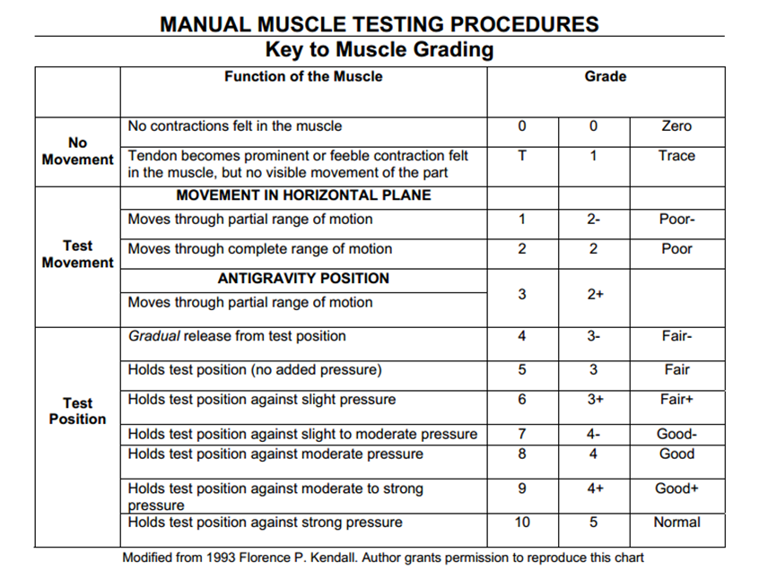
Manual
Muscle
Testing

Slide 10
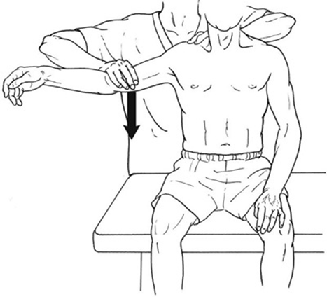
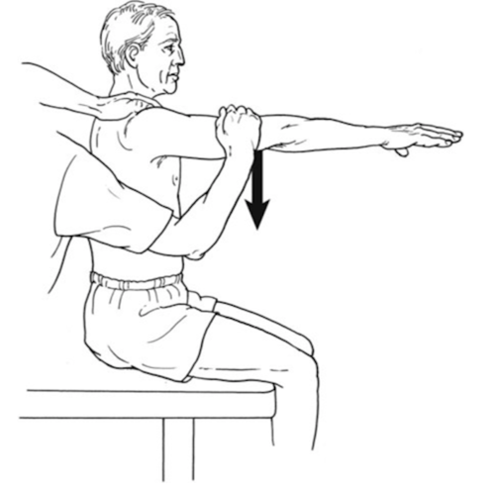
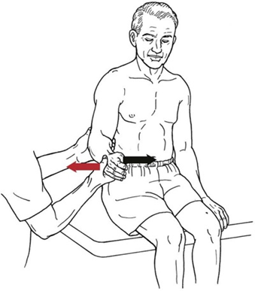
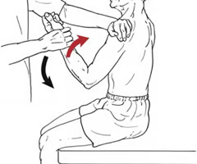
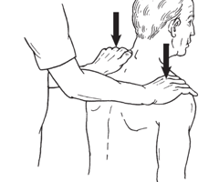
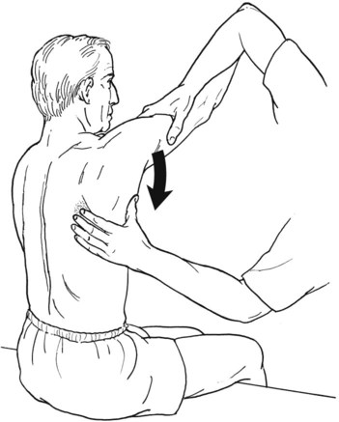
Manual Muscle Testing

Slide 11
STRESS TESTS
Apley’s Scratch Test
Looks at the mobility of the shoulder joint as a whole
Patient attempts to touch their opposite anterior shoulder, their opposite scapula reaching overhand, then the inferior angle of their opposite scapula reaching underhand
Abnormal Findings: inability to reach one of three places, pain, discomfort, popping
(+) impingement syndrome, subacromial bursitis, swelling, rotator cuff tendinitis

Slide 12
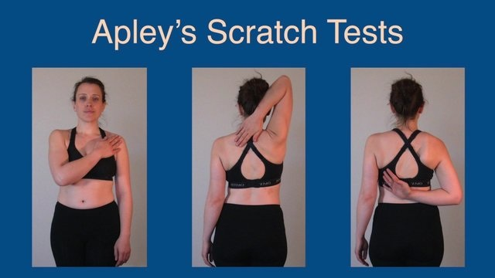
https://shouldercomplexgocatsnmu.weebly.com/special-tests.html

Slide 13
Stress tests
Napoleon Sign
Test the subscapularis
Seated or supine, patient presses their hand into their stomach as strong as possible with the elbow flexed to 90°
Abnormal findings: Pain, discomfort, or weakness with muscle contraction
(+) Subscapularis strain or tendinitis

Slide 14
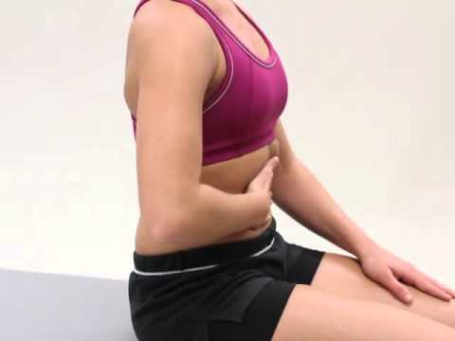

Slide 15
Stress Tests
Empty/Full Can Test
Evaluates the supraspinatus
Patient’s shoulder is slightly abducted & flexed with the arm extended & hand fully pronated. Examiner resists shoulder flexion & abduction by placing a hand on the patients forearm & preventing upward movement. Then, the patient fully supinates their hand, & abduction is resisted again
Abnormal Findings: pain, discomfort, weakness, popping
(+) supraspinatus strain, tear, or tendinitis

Slide 16
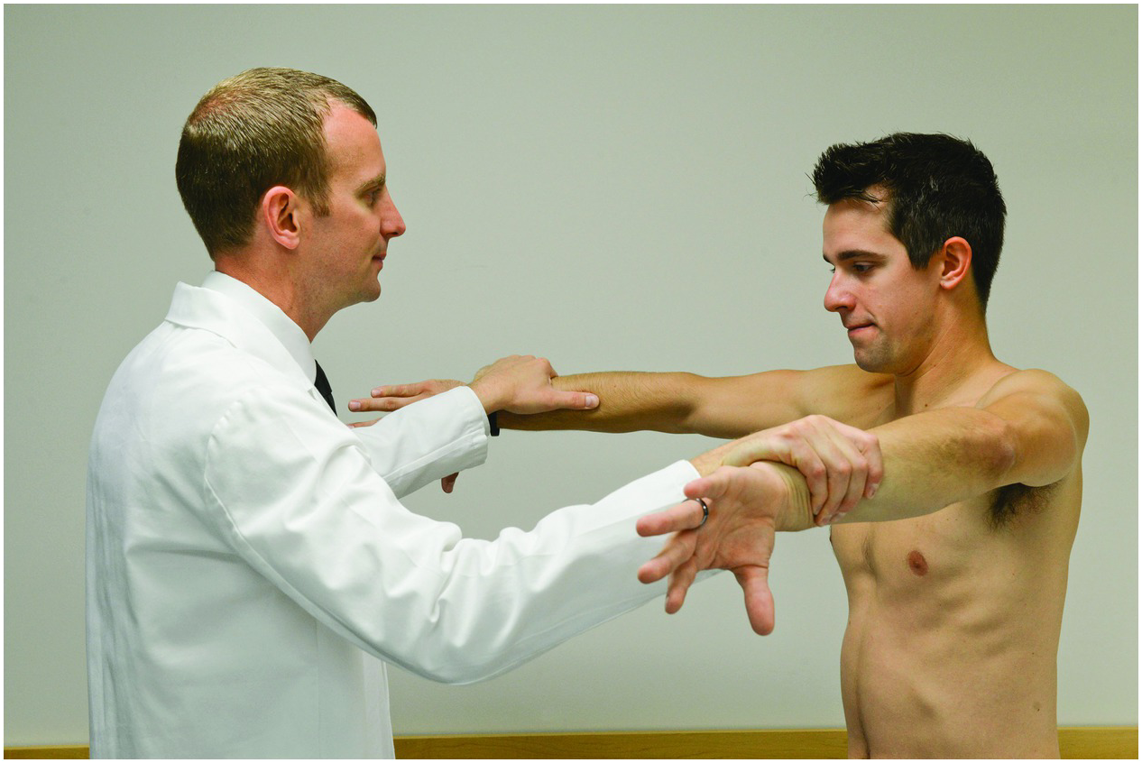
https://www.cambridge.org/core/books/sports-medicine-for-the-emergency-physician/shoulder/58E0A2B021C962E80D188D881885EFA2

Slide 17
Stress Tests
Dropping Sign
Evaluates the infraspinatus
Patient sits or stands with their elbows flexed to 90°, arms relaxed. The examiner abducts the shoulder to 90°, then PASSIVELY externally rotates the shoulder into near full ROM. Then the examiner releases the hand, looking for the ability to maintain their arm in this position.
Abnormal Findings: Dropping the wrist, pain, weakness, discomfort, popping
(+) infraspinatus strain, tear, or tendinitis

Slide 18
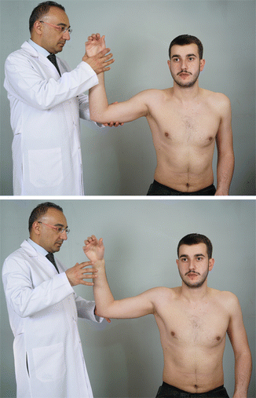
https://musculoskeletalkey.com/physical-examination-4/

Slide 19
Stress Tests
Speed Test
Tests the biceps brachii or the labrum
Patient’s arm is fully extended, shoulder is flexed to 75-90°, hand is supinated. Examiner palpates the bicipital groove with two or three fingers using one hand, & resists shoulder flexion with the other
Abnormal Findings: pain @ the bicep tendons, weakness or pain @ the GH joint/Labrum
(+) Biceps strain, tendinitis, or labrum injury

Slide 20
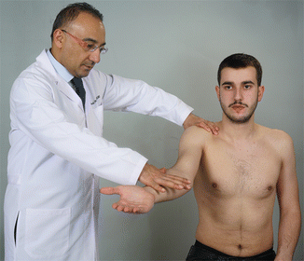
https://musculoskeletalkey.com/physical-examination-4/

Slide 21
Stress Tests
Sulcus Sign
Tests the integrity of the deltoid muscles
Patient’s arms are straight at their sides. Examiner grasps the forearm & pulls straight down, checking the deltoid muscles for deformity
Abnormal Findings: visible “dent” in the deltoid muscle, pain, discomfort
(+) Deltoid muscle strain, tear

Slide 22
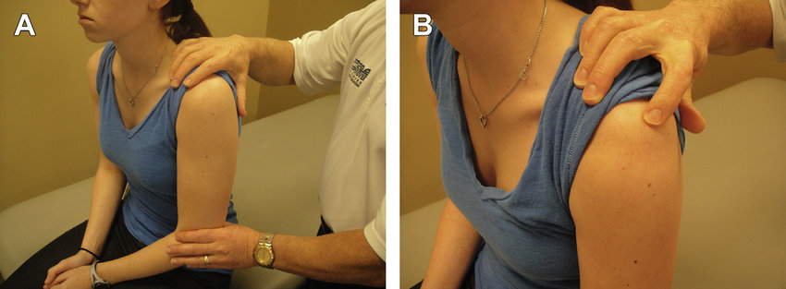
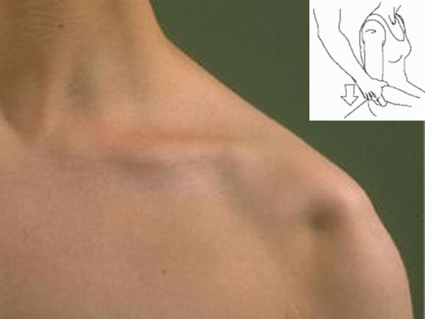
https://www.researchgate.net/figure/Sulcus-sign-to-assess-glenohumeral-laxity-A-Position-to-assess-a-sulcus-sign-in-a_fig3_257247943
https://www.orthobullets.com/shoulder-and-elbow/3052/multidirectional-shoulder-instability-mdi

Slide 23
Stress Tests
Painful Arc Test
Tests for subacromial impingement or Bursitis
Patient should be standing without obstructions to their sides. Instruct the patient to abduct their uninvolved shoulder FIRST through their full ROM. Repeat on the involved side
Abnormal findings: pain in the 60-120° ROM or 180°, especially if pain increases.
(+) AC Joint disorder, Impingement, Bursitis

Slide 24
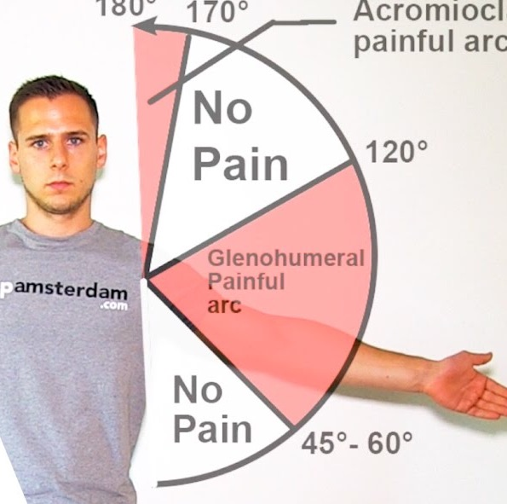
http://www.rotheryhealth.com/2018/01/painful-shoulder/

Slide 25
STRESS TESTS
O’Brien’s Test
Evaluates the labrum for a SLAP (superior labrum, anterior-to-posterior) tear; alternate for biceps tendinopathy
Patient is seated with arm extended, shoulder is flexed to 90°, & abducted to 10°, hand is fully PRONATED. Examiner resists shoulder flexion. Patient then fully SUPINATES the hand & examiner resists flexion again, noting for differences.
Abnormal Findings: Pain in PRONATION that is RELIEVED in SUPINATION, pain, discomfort, popping/catching
(+) SLAP Tear, Labrum injury, biceps tendinopathy

Slide 26
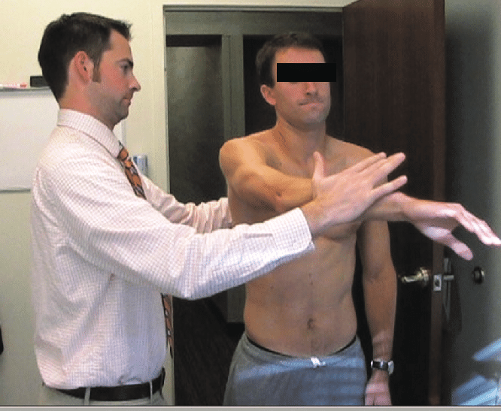
https://www.researchgate.net/figure/OBrien-test-to-detect-a-SLAP-tear_fig4_233976396

Slide 27
Stress Tests
Piano Key Sign/Test
AC Ligament/Joint integrity
Patient sits or stands facing the clinician with arms resting at their sides. The clinician palpates for the distal end of the clavicle, just medial to the acromion process & applies downward force to the joint. Repeat on the injured side!
Abnormal Findings: pain @ AC Joint, “springing” sensation seen or felt as the ligament is relaxed then manually overstretched
(+) AC Joint Sprain, Shoulder Separation

Slide 28
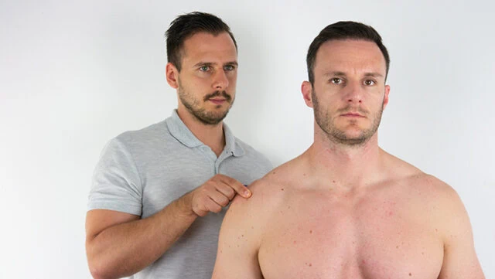
https://www.google.com/url?sa=i&url=https%3A%2F%2Fwww.physiotutors.com%2Fwiki%2Fac-joint-line-tenderness%2F&psig=AOvVaw03buvSnd7Bp5aX_ORboZaJ&ust=1692803252881000&source=images&cd=vfe&opi=89978449&ved=0CA0QjRxqFwoTCLjJ3-bF8IADFQAAAAAdAAAAABAD

Slide 29
Stress Tests
Anterior Slide Test
Tests the labrum; may detect a fracture @ the acromion or coracoid processes
Patient stands with hands on their hips. Examiner needs to stabilize the patient’s torso, then applies an axial load from the elbow to compress the labrum
Abnormal Findings: Pain, discomfort, popping heard or felt
(+) Superior Labrum Tear/Injury

Slide 30
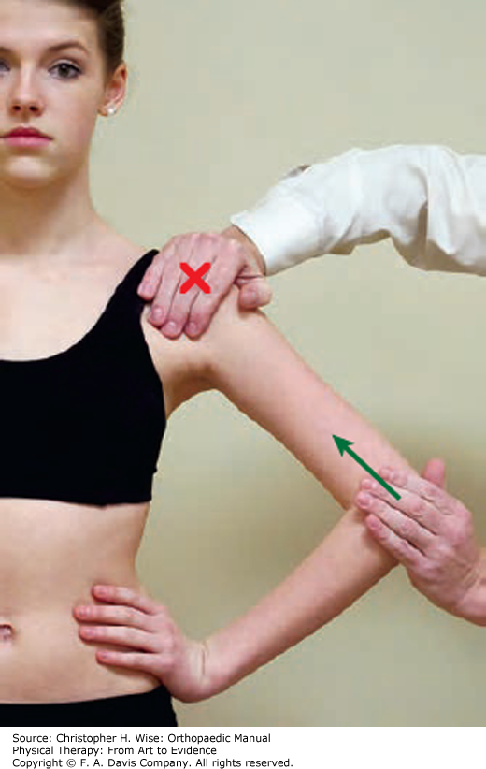

Slide 31
Stress Tests
Kim Test
Tests the labrum; may detect a fracture @ the acromion or coracoid processes
From the anterior slide test, patient keeps their arm flexed at 90° & raises the arm over their head. Examiner will stabilize the torso again, then apply the same axial load at the elbow to compress the labrum
Abnormal Findings: Pain, discomfort, popping heard or felt
(+) Inferior Labrum Tear/Injury

Slide 32
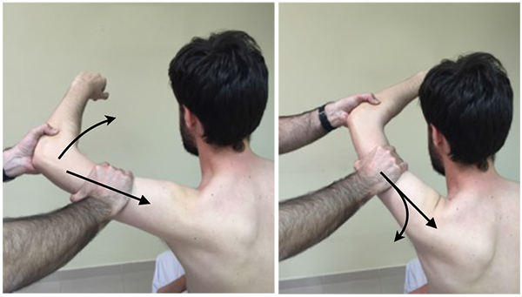
https://openorthopaedicsjournal.com/VOLUME/11/PAGE/861/

